Slide 1
Data
Store all the bits

Slide 2



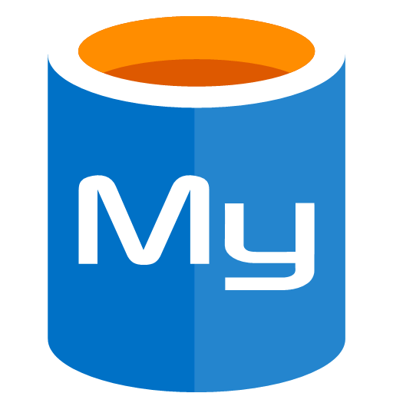
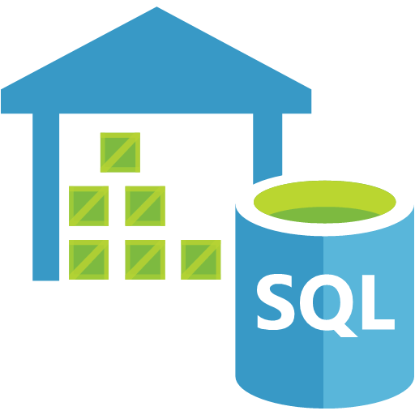
Database Options
Notes:
SQL
Document DB
CosmosDB
MySQL
SQL Data Warehouse

Slide 3
When to use which?
Data Service | Scenario
Cosmos DB | Large non-relational global
Azure SQL | Scales, performant, familiar
SQL Server on a VM | Your own SQL server, but in the cloud
MySQL, PostGreSQL | Like Azure SQL, but different
Data Lake | Massively parallel analytics
SQL Data Warehouse | Fully managed, elastic data warehouse
And many more…

Slide 4




Storage
Notes:
Storage solutions

Slide 5
Data APIs
Nuget
Nuget
Nuget
Notes:
API and SDK to talk to data

Slide 6
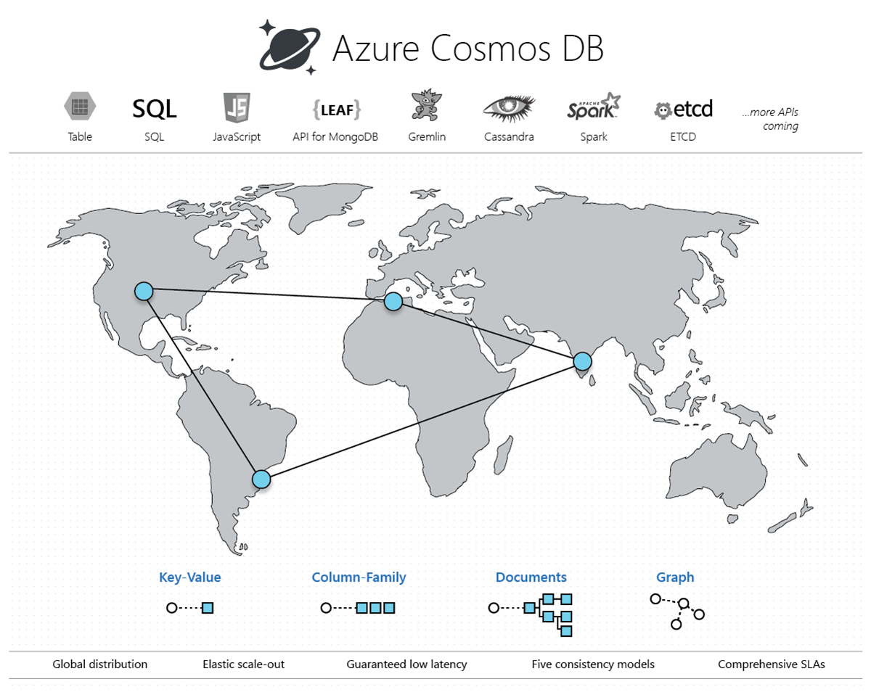
Cosmos DB
Notes:
globally distributed, multi-model database service
elastically and independently scale throughput and storage across any number of Azure regions worldwide
single-digit-millisecond data access using your favorite API including SQL, MongoDB, Cassandra, Tables, or Gremlin. Cosmos DB

Slide 7
Cosmos DB Layers
Account
Database
Database
Container
Container
Container
Container
Container
Container
Notes:
Account, choose regions for data.
Database, A Cosmos database is a unit of management for a set of containers.
Containers is the unit of scalability for both throughput and storage.

